Slide 1


PAKISTAN STATE OIL COMPANY LIMITED
Every journey begins here

Slide 2

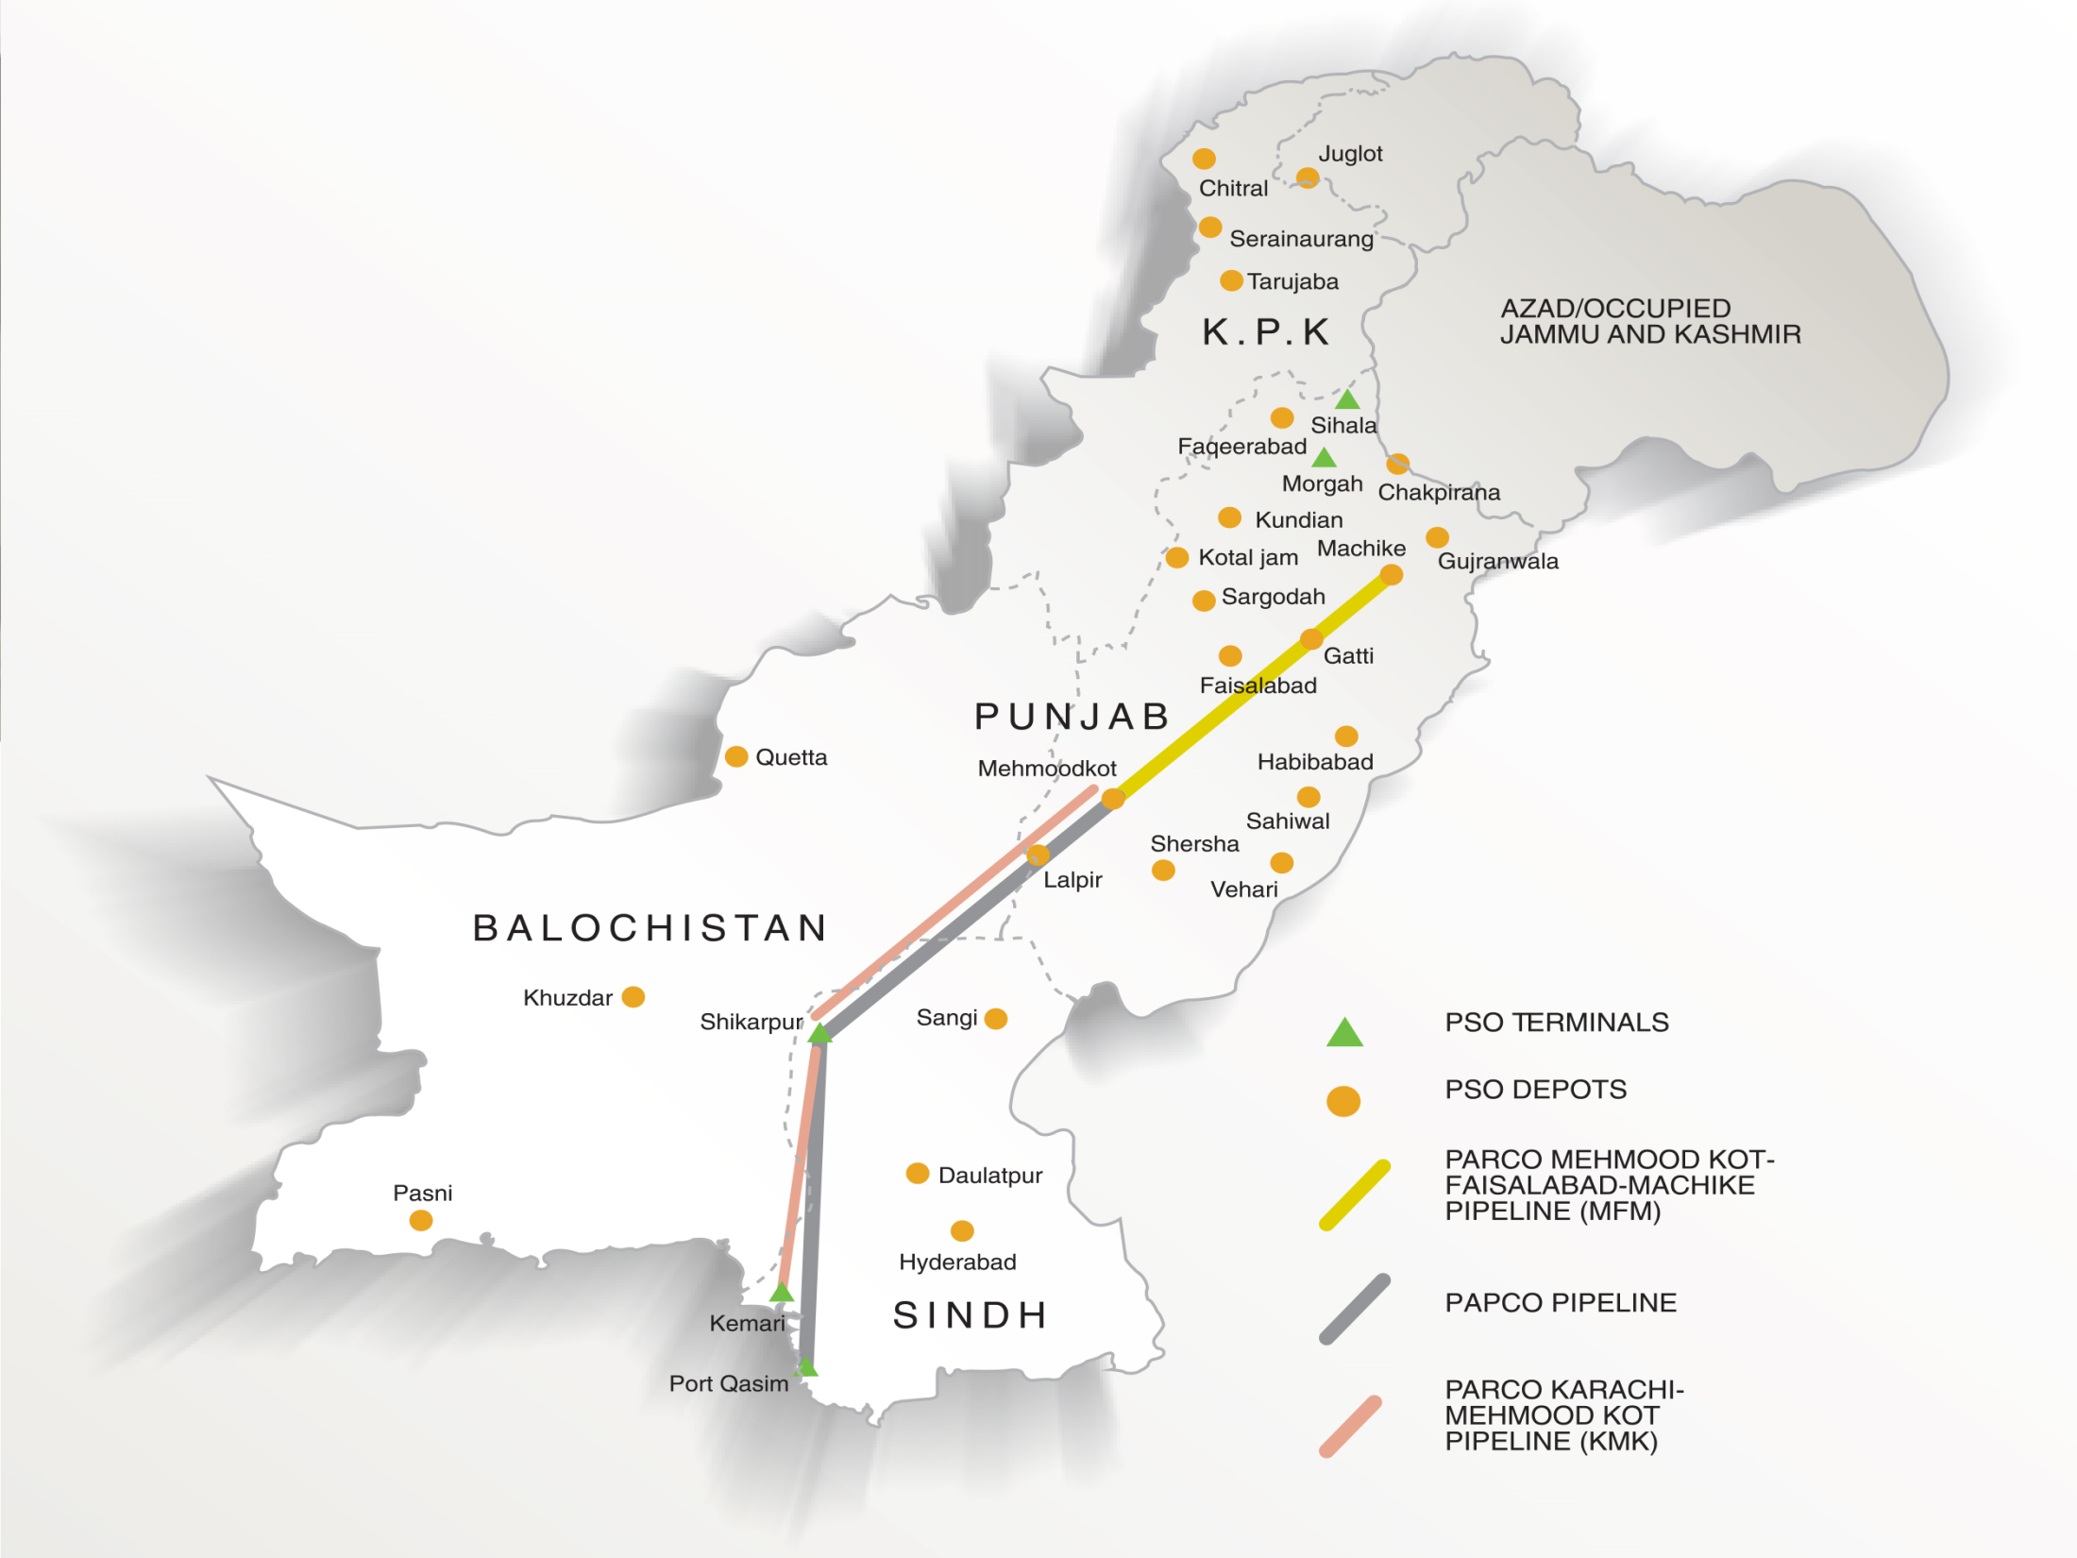

PAKISTAN STATE OIL
We are the biggest energy company of Pakistan that has invested in the storage and retail network infrastructure alongside human capital to ensure a superior experience and best quality products to our valued consumer.
More than 55%
Market Share in POL
Shareholding in WOPP
Karachi to MehmoodKot
59%
OMC Import
Over PKR 2.5 Trillion
Annual Turnover
11,000+
Fleet of Tank Lorries
1.232 MMT
47% of OMC Storage
First OMC to Launch
EURO-V Standard Fuels
4,000+ OGRA Compliant
Fleet of Tank Lorries
19 Depots
9 Installations
Pioneer of introducing FS CK-4 HDDEO
14 Airports
3 Seaports
World Class
Quality Lubricants
24
ISO Certified MQTUs
3500+
Retail Outlets
R&D
Customized Lubricants
Over 3 Million
Consumers Per day
State of Art LMT
Capacity 50,000 MT
Pioneer
Fuel Cards Business
Automated Filling
Keamari, Machike, Sihala
Lube Raw Material
Strg. Capacity 6,000 MT
1

Slide 3
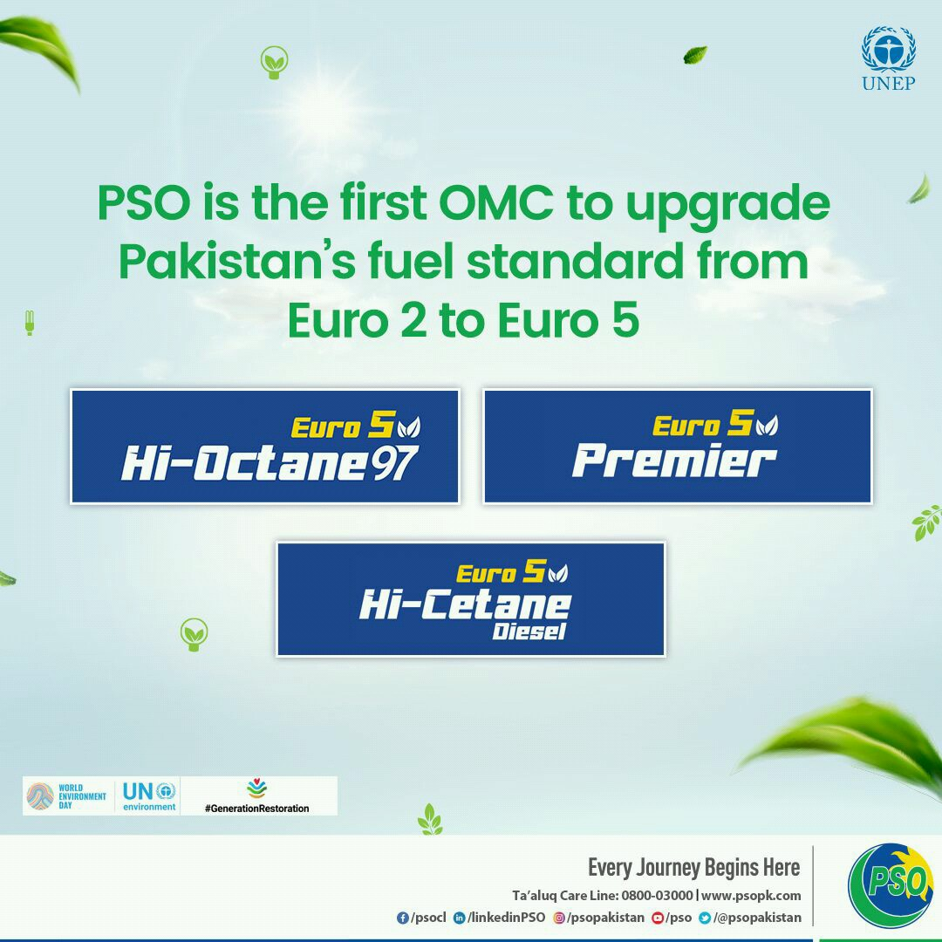
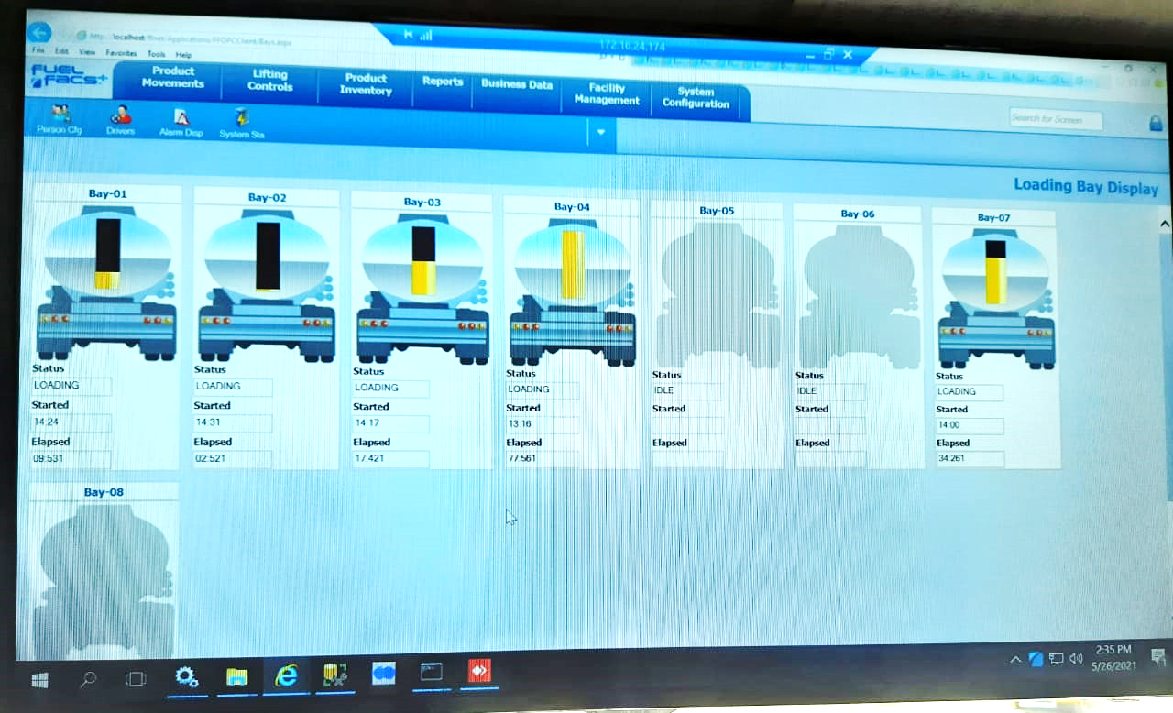
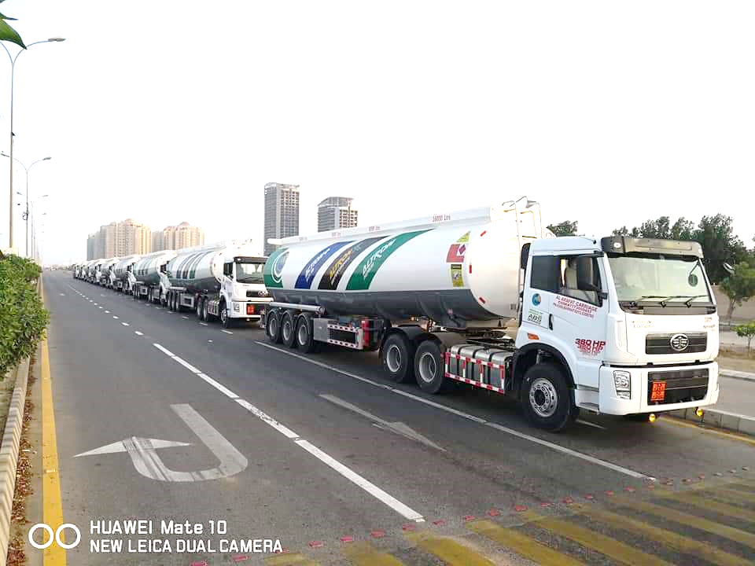
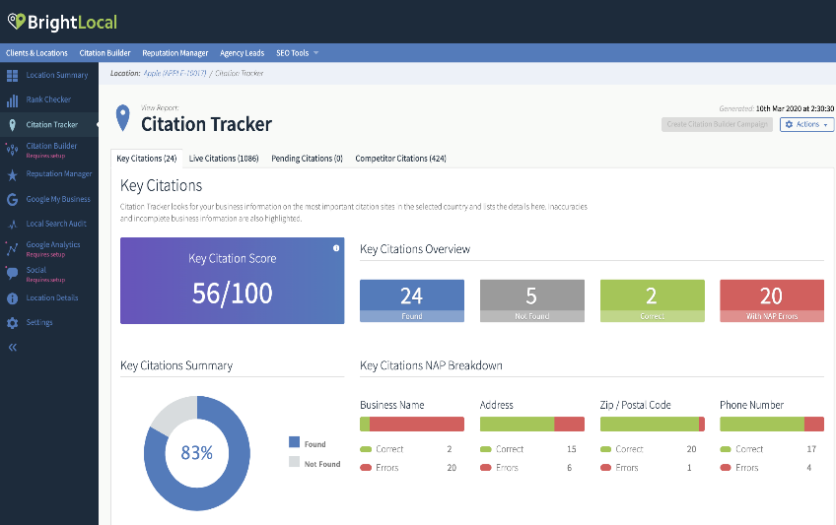
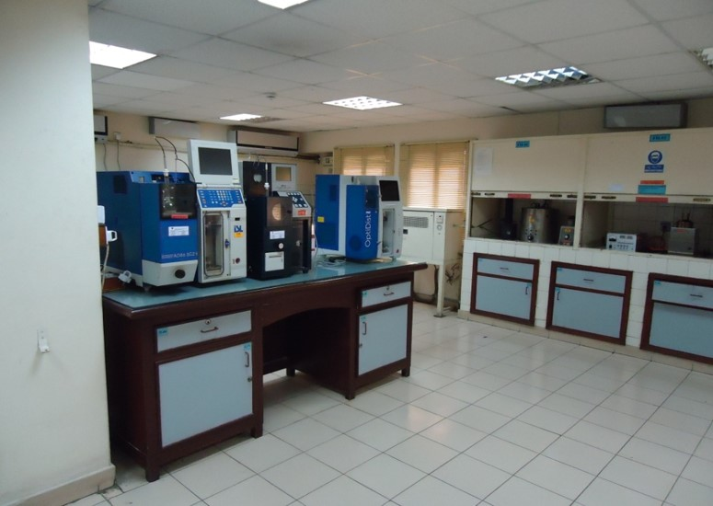

PAKISTAN STATE OIL
First to Introduce
Euro-V Standard Fuel
Automated Filling Operations at Terminal
OGRA & NHA Compliant Fleet
Tank Lorry Tracking Facility Available
On-Site Fuel Testing Facility
ISO Certified POL Testing Laboratory
2

Slide 4

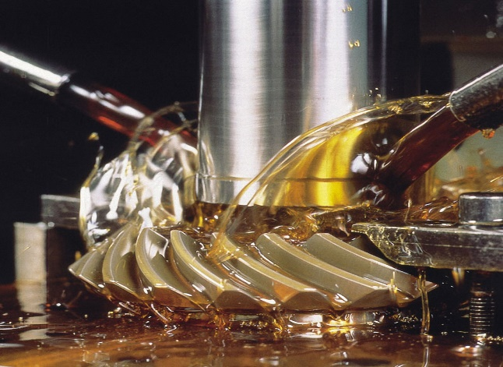

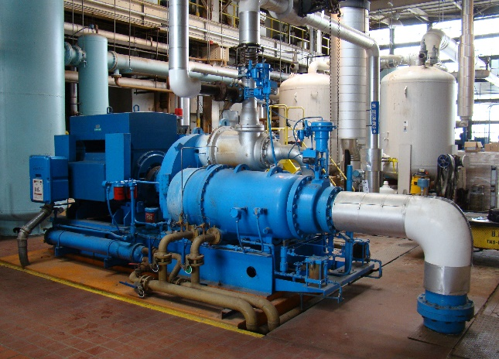

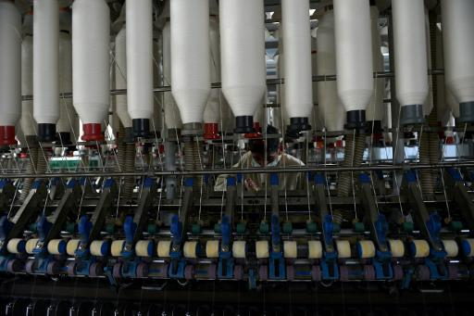
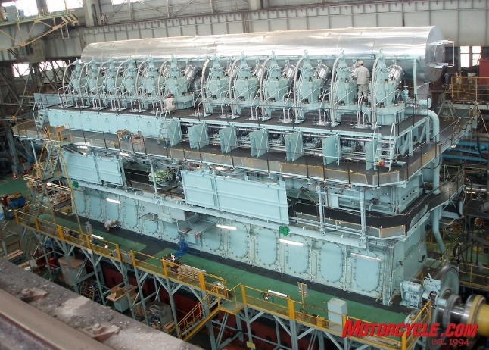
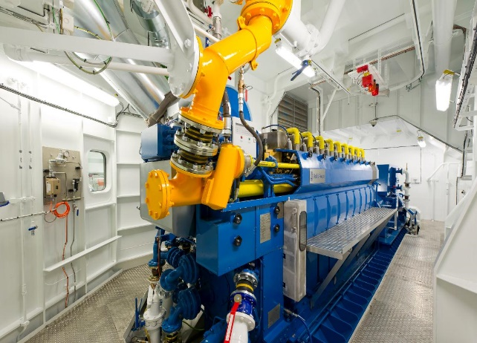
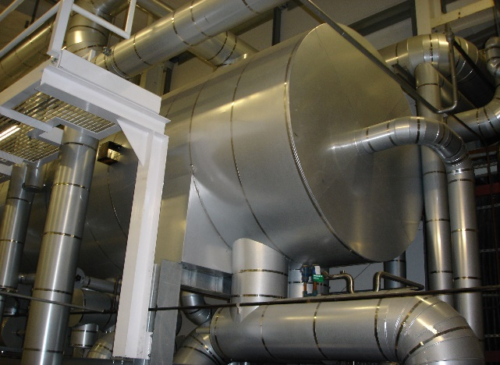

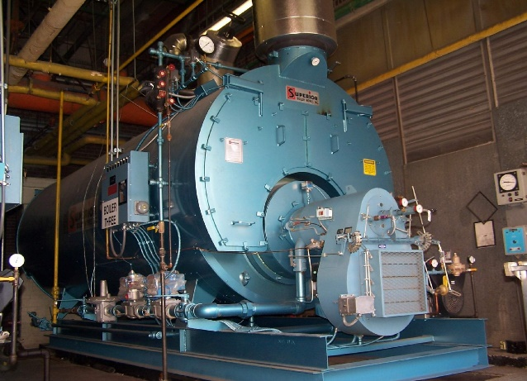
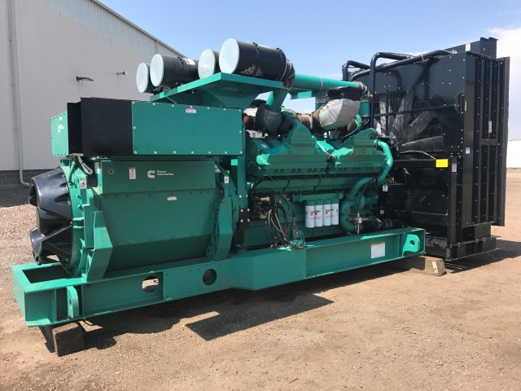
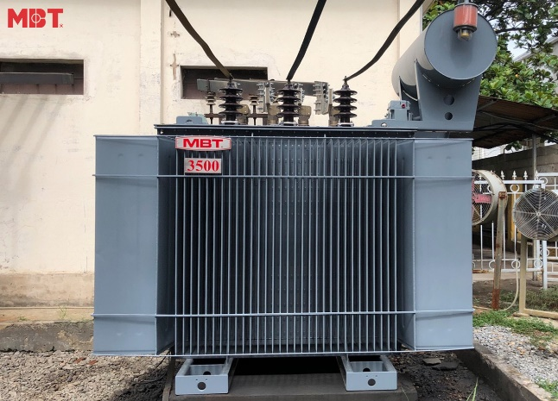
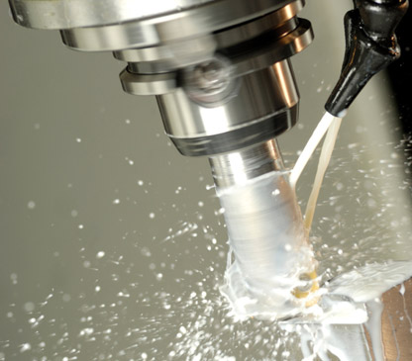
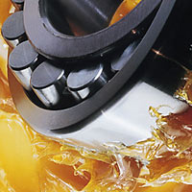
PAKISTAN STATE OIL
Open Gears
Industrial Gears
Steam & Gas Turbines
Air Compressors
Hydraulic Systems
Machines & Spindles
Gear & Transmission
Marine Engines
Gas Engines
Thermal oil Boiler
Refrigeration Systems
Diesel Gen. sets
Transformers
Metal Working
Bearing Applications
3

Slide 5
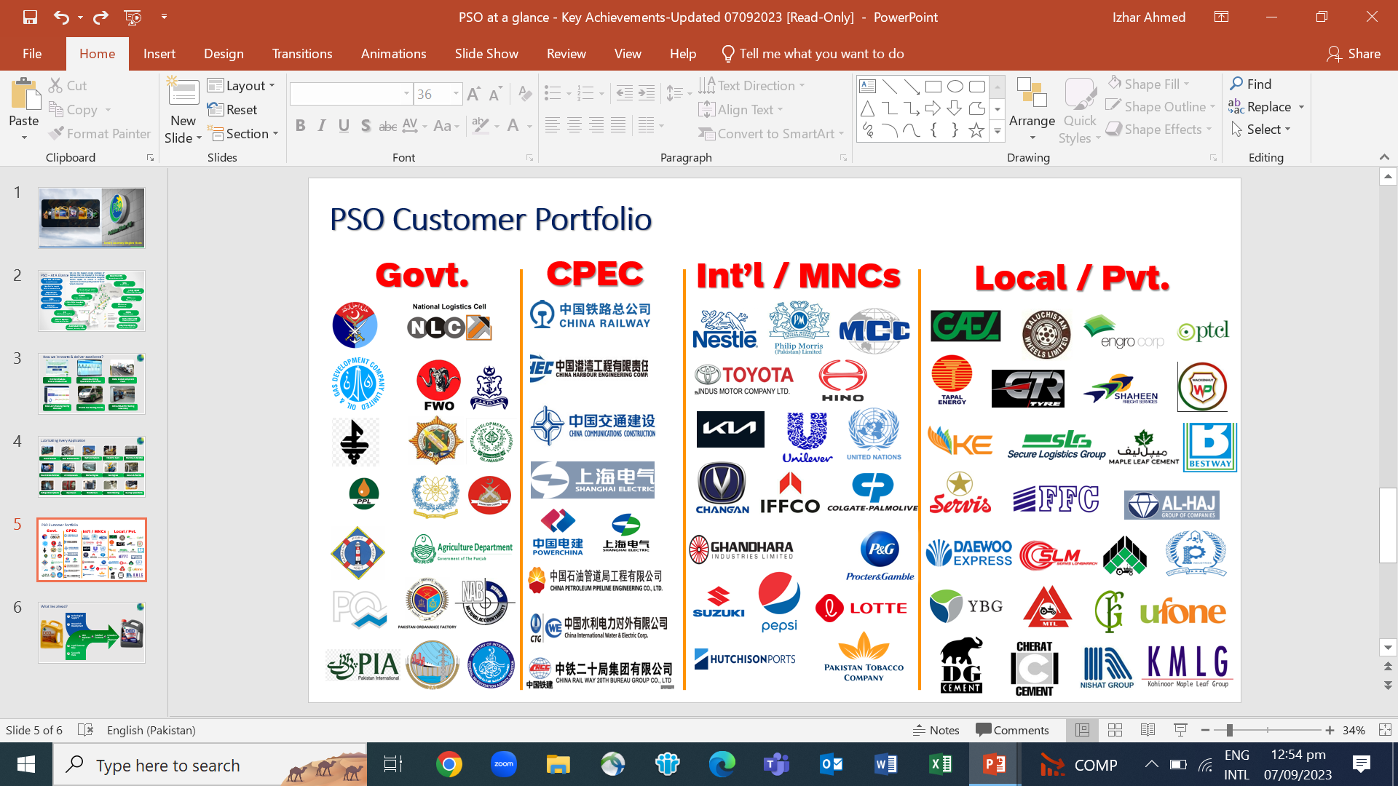
PAKISTAN STATE OIL
4

Slide 6

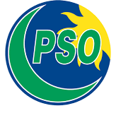
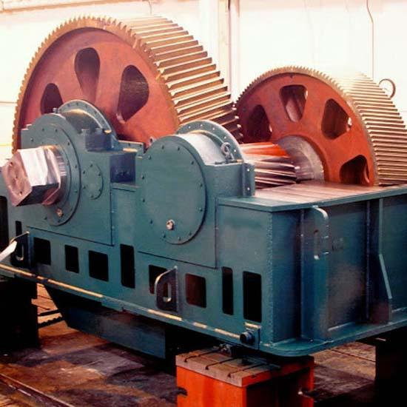
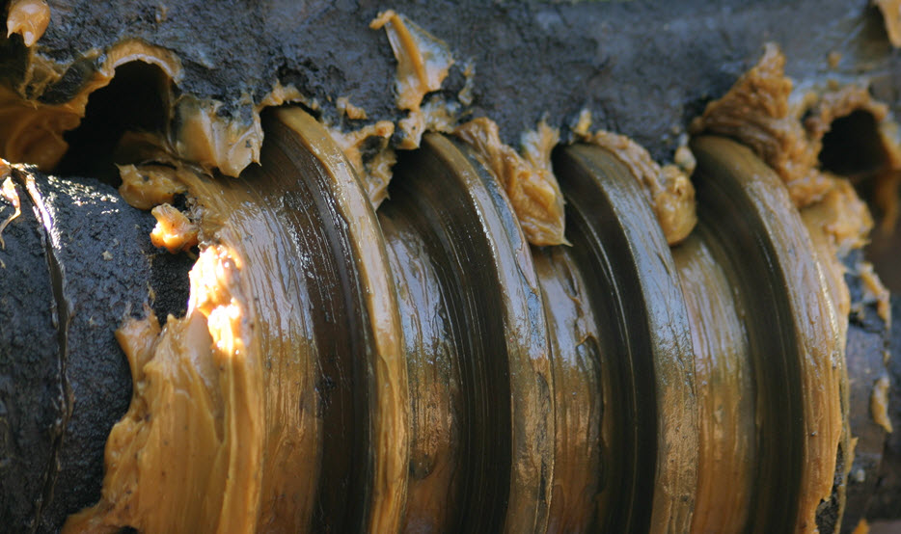
PSO Lubricants for Sugar Industry
Bitumen based Sugar Mill Oil
Industrial Gear Oil
Greases
Hydraulic Oil
Turbine Oil
Compressor Oil
6

Slide 7

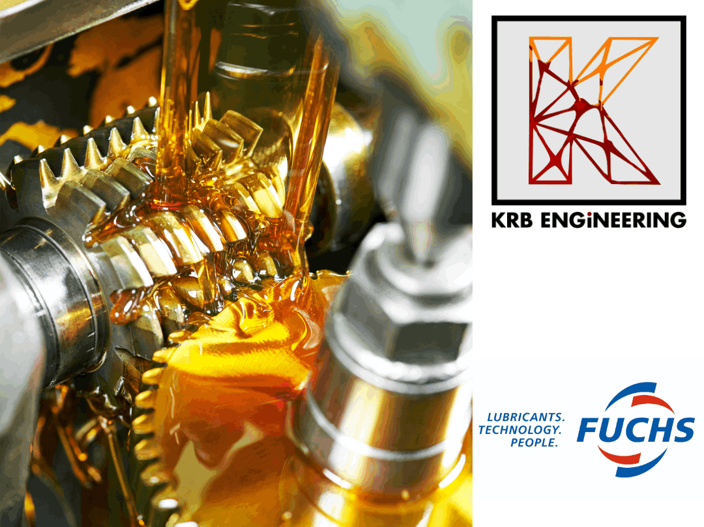
PSO LUBRICANTS-Research & Development
Continuous improvement in PSO lubricants.
Addition of new and latest lubricants to meet future requirement.
Customized solution for :
Industrial Lubricants
Automotive Lubricants
5

Slide 8


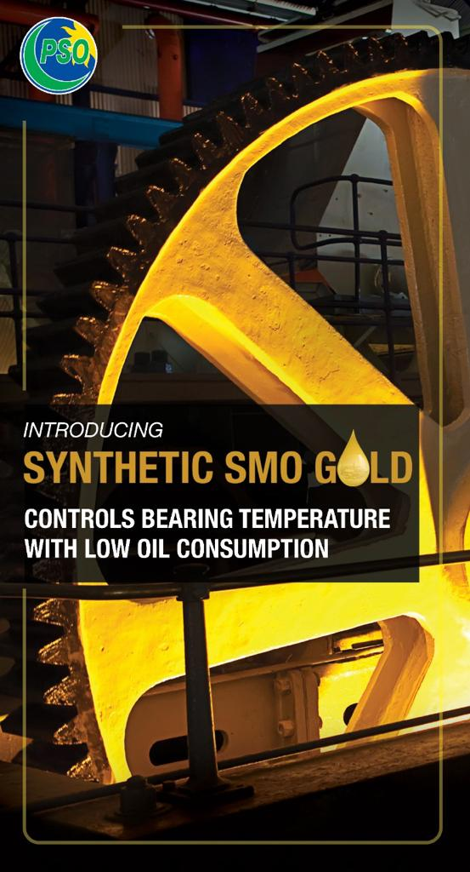
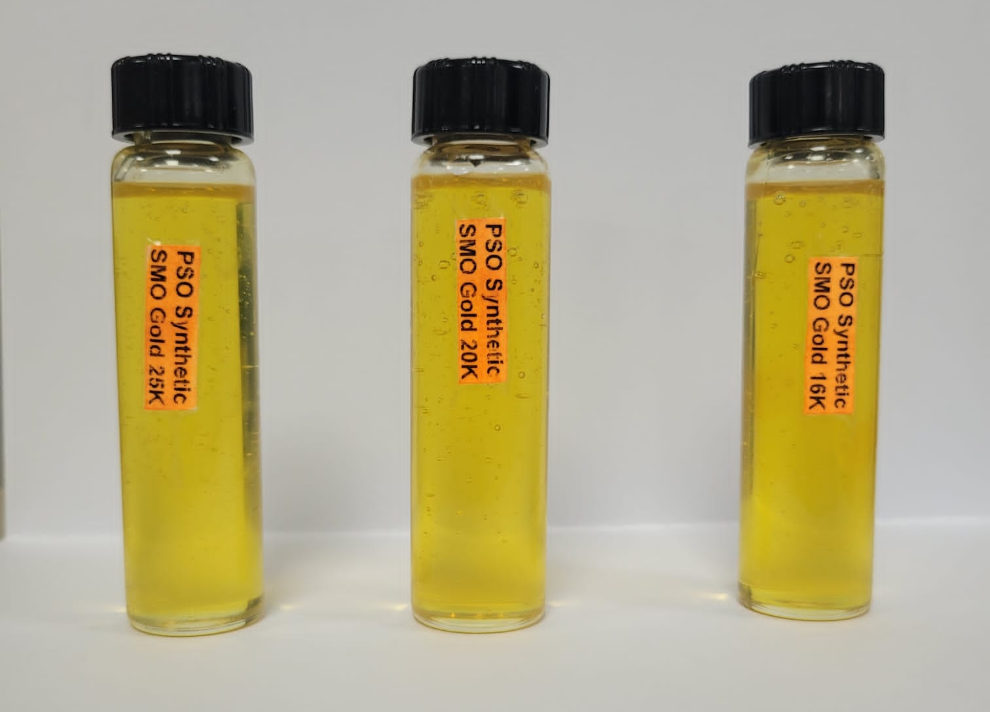
PSO SYNTHETIC SMO GOLD
Available in three viscosity grades
7

Slide 9
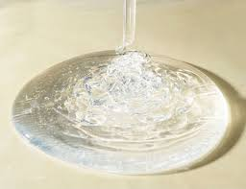

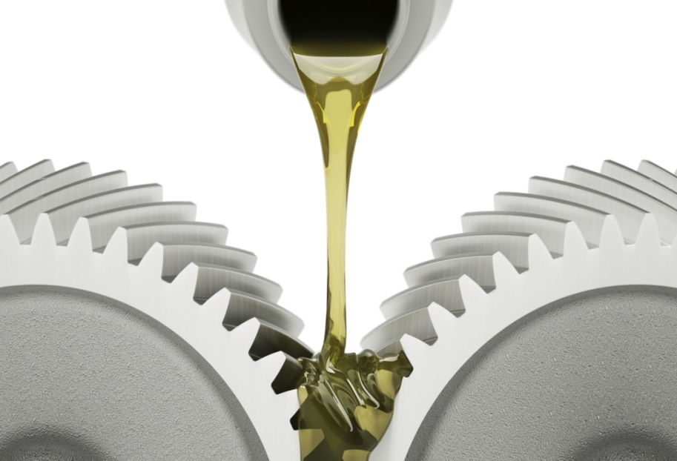

PSO SYNTHETIC SMO GOLD
COMPONENTS:
Superior Synthetic Components – Balanced combination of Highly reactive and Stabilized components
High viscosity base oil
Extreme pressure additives
8

Slide 10
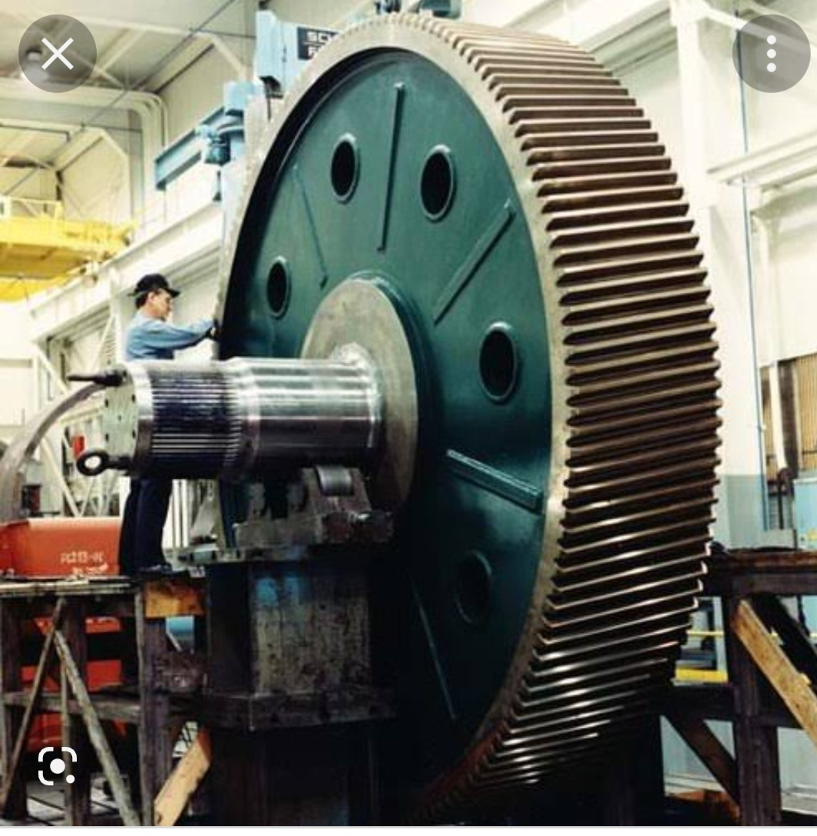
PSO SYNTHETIC SMO GOLD
APPLICATIONS:
A premium lubricant specifically formulated to meet the demanding requirements of sugar mill roll bearings and gear lubrication.
Their high viscosities in combination with enhanced additive packages including tackifiers enable them to provide exceptional protection to heavily loaded slow speed roll bearings, gearboxes and open gears in applications where high volumes of process water, corrosive cane juice, dust and bagasse contamination are major challenges.
Offers the same key benefits as SUGAR MILL OIL but with the additional feature of being clear to enable visual inspection of components without the need to clean up first.
9

Slide 11
PSO SYNTHETIC SMO GOLD-Functional Benefits
Possesses high shear stability
Smooth Oil Flowability at low temperatures
Reduces maintenance cost and increases bearing and gear service life
Proper lubrication at low temperature
Maintains viscosity at elevated temperatures
Equally suitable at high operating conditions
10

Slide 12
PSO SYNTHETIC SMO GOLD-Functional Benefits
Maintains bearing temperature even under extreme operating conditions
Excellent load carrying and extreme pressure handling properties
Maintains oil film strength to keep surfaces apart
Protection against bearing wear and tear
11

Slide 13
PSO SYNTHETIC SMO GOLD-Functional Benefits
Incorporates tackiness additive
Excellent water resistance provides
Improved corrosion resistance
Supports reduced oil consumption
12

Slide 14
PSO SYNTHETIC SMO GOLD-Typical Characteristics
PROPERTIES | METHOD | TYPICAL RESULTS
 |  | 16K | 20K | 25K
Appearance | Visual | Bright & Clear | Bright & Clear | Bright & Clear
Color | ASTM D-1500 | L 3.0 | L 3.0 | L 3.0
Density @ 15 °C, Kg/liter | ASTM D-4052 | 0.9119 | 0.9110 | 0.9101
Kinematic Viscosity @ 40 °C, cSt | ASTM D-445 | 16,100 | 20,100 | 25,100
Kinematic Viscosity @ 100 °C, cSt | ASTM D-445 | 526 | 616 | 750
Flash Point (COC), °C | ASTM D-92 | 224 | 222 | 222
Pour Point, °C | ASTM D-97 | 6 | 9 | 9
Viscosity Index | ASTM D-2270 | 176 | 180 | 190
13

Slide 15
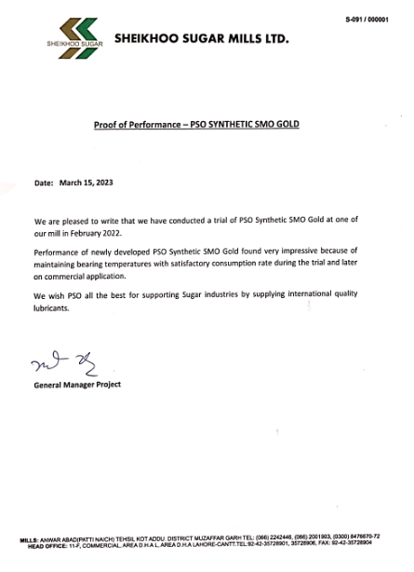
PSO SYNTHETIC SMO GOLD-Proof of Performance
14

Slide 16
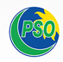
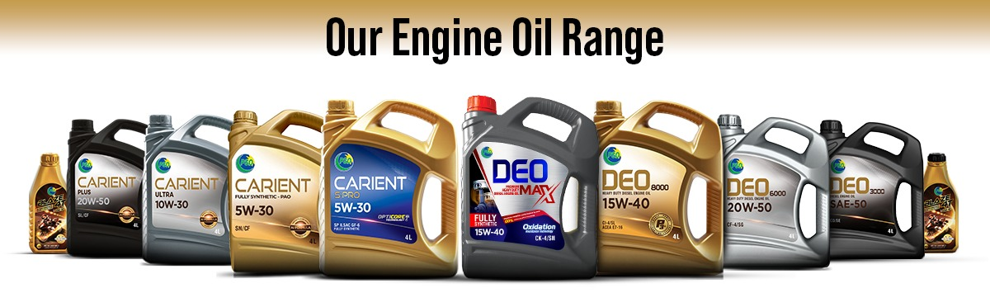
PAKISTAN STATE OIL
PSO AUTOMOTIVE LUBRICANTS
15

Slide 17
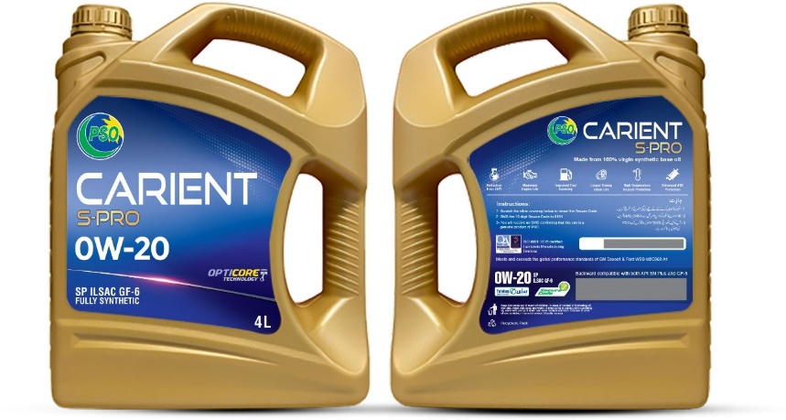

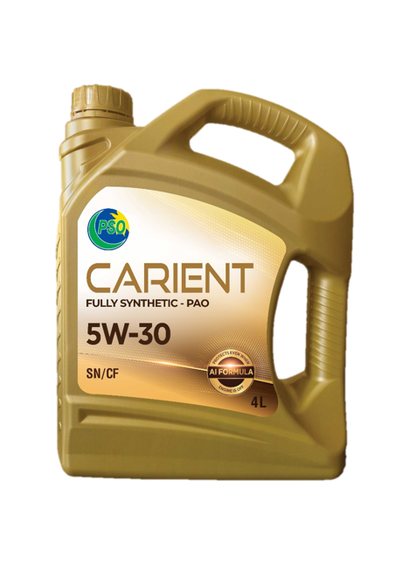
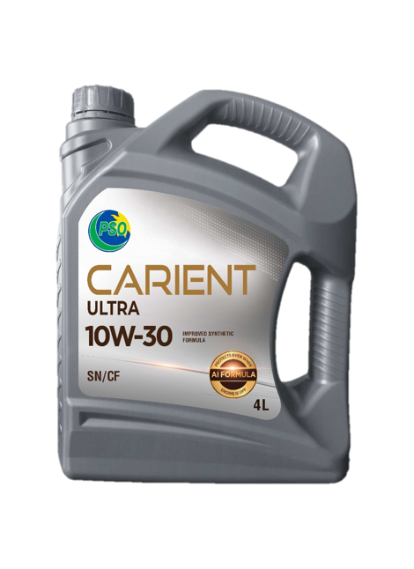
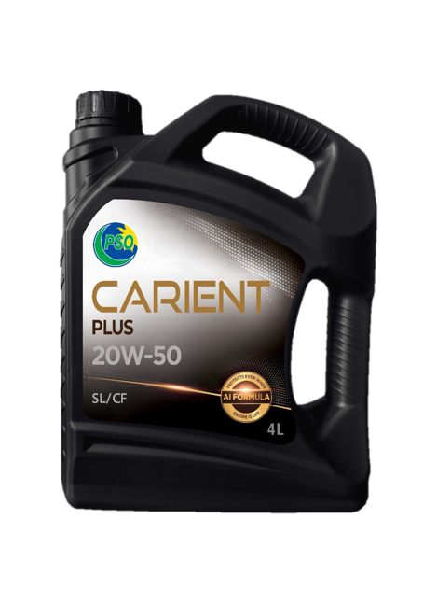
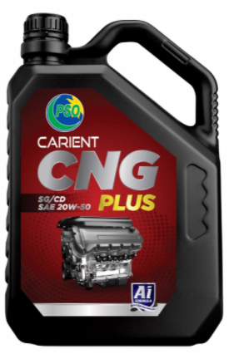
PAKISTAN STATE OIL
PSO CARIENT Series - Petrol Engine Oil
16

Slide 18
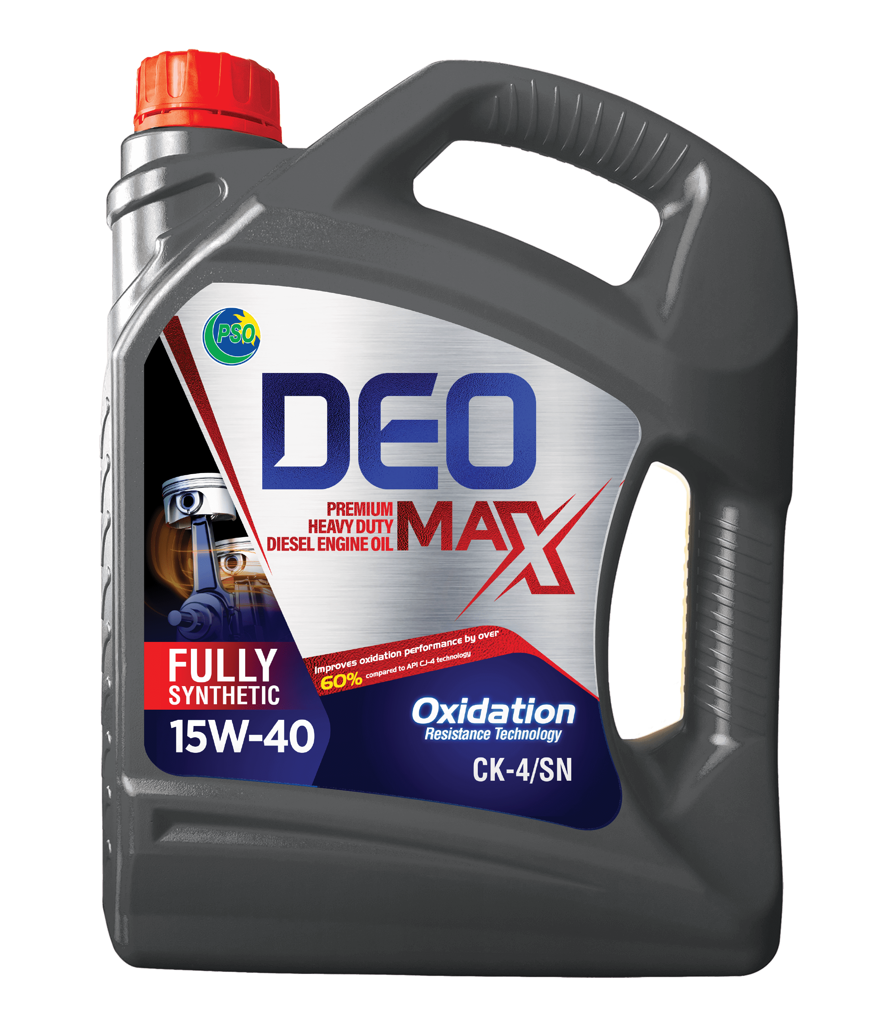

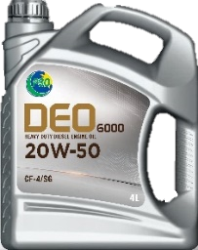
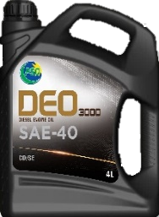
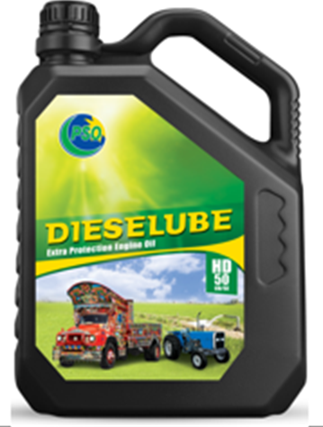
PAKISTAN STATE OIL
PSO DEO Series-Diesel Engine Oil
17

Slide 19
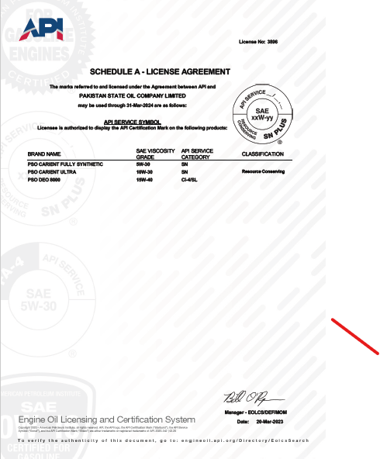
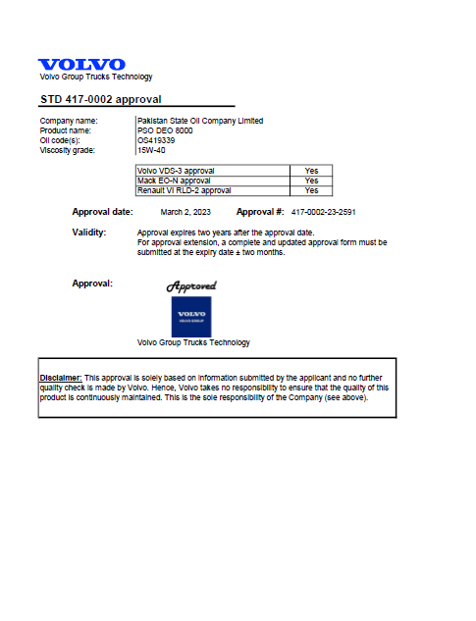
PAKISTAN STATE OIL
API License & OEM Approval-Volvo Group Trucks Technology
18

Slide 20
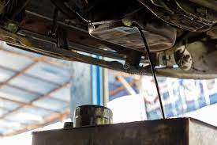
PAKISTAN STATE OIL-Lubricant after sales services
Used Oil Analysis Program
PSO Oil Watch Program provides lubricants after sale technical advisory services through Used Oil testing.
Used oil analysis is an important part of engine/equipment maintenance.
The program includes information sharing with customer about the condition of oil in use and its suitability for further use. Another advantage of the program is monitoring condition of engine/equipment lubricated by the oil.
19

Slide 21
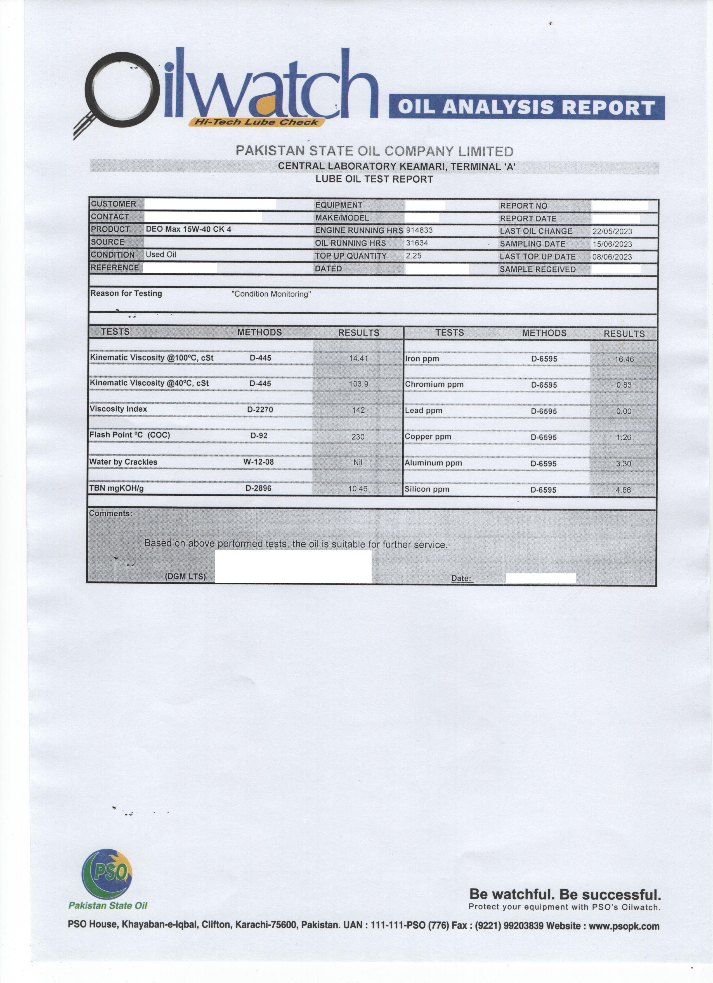
PAKISTAN STATE OIL-Lubricant after sales services
Used Oil Analysis-PSO Oil Watch Program
The program consists of detailed testing of used oil at well-equipped PSO laboratory and technical interpretation of test results and advises further to get maximum benefits of oil and optimizing oil drain intervals.
Oil testing & interpretation of results is based on sample being taken according to reliable procedure.
THANK YOU
20

